Slide 1
title of your presentation
Max. 3 lines
Meaningful subtitle
Presenter and/or authors

Slide 2
Header of this slide
Text level 1
  Text level 2 [1]
    Text level 3
      Text level 4
Text level 1
  Text level 2
Text level 1
[1] M. Musterfrau et al., "Amazing new technique for better decision support for cardiologists – an experiment with data from a clinical trial", Journal of your choice, edition (year), pp. 123- 131

Slide 3
Header for this slide
Subheader for this slide
Text level 1
  Text level 2
    Text level 3

Slide 4
Header for a 2 column slide
Text level 1
  Text level 2
    Text level 3
Text level 1
Text level 1
Text level 1
  Text level 2
    Text level 3

Slide 5
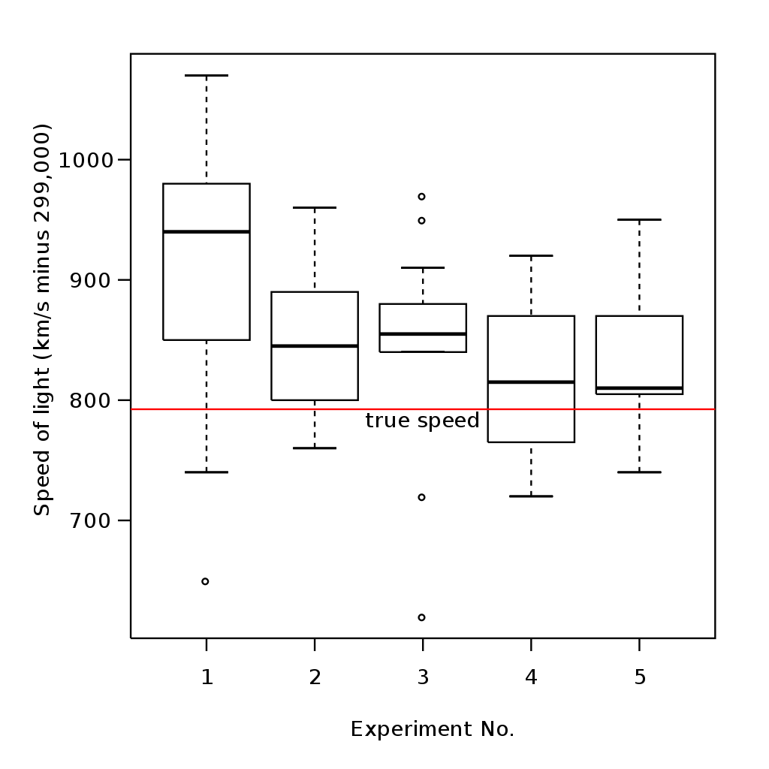
Header for a mixed slide
Text level 1
  Text level 2
Text level 1
  Text level 2
    Text level 3

Slide 6
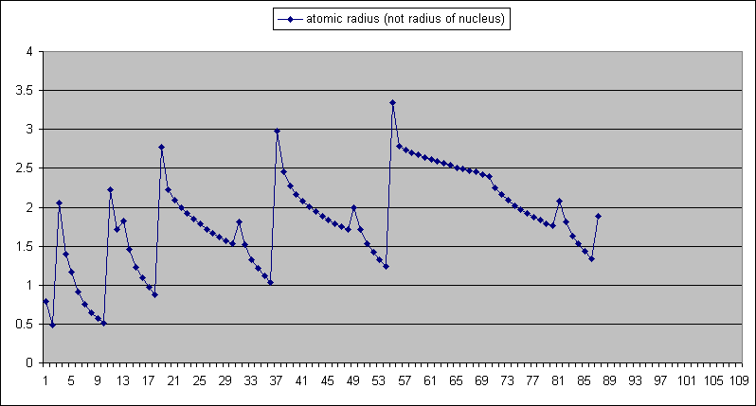
Header for an image-only slide

